Slide 1
Working with Dataflows
Working with Dataflows

Slide 2
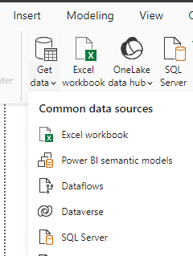
Working with Data flows
Note: This lab requires a Power BI Services account with administrator privileges.
Open Power BI Desktop, select Dataflows

Slide 3
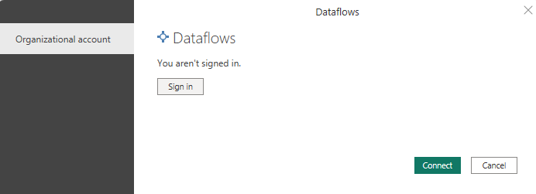
Working with Data flows
Click Connect
Note: We must sign in with Power bi services account

Slide 4
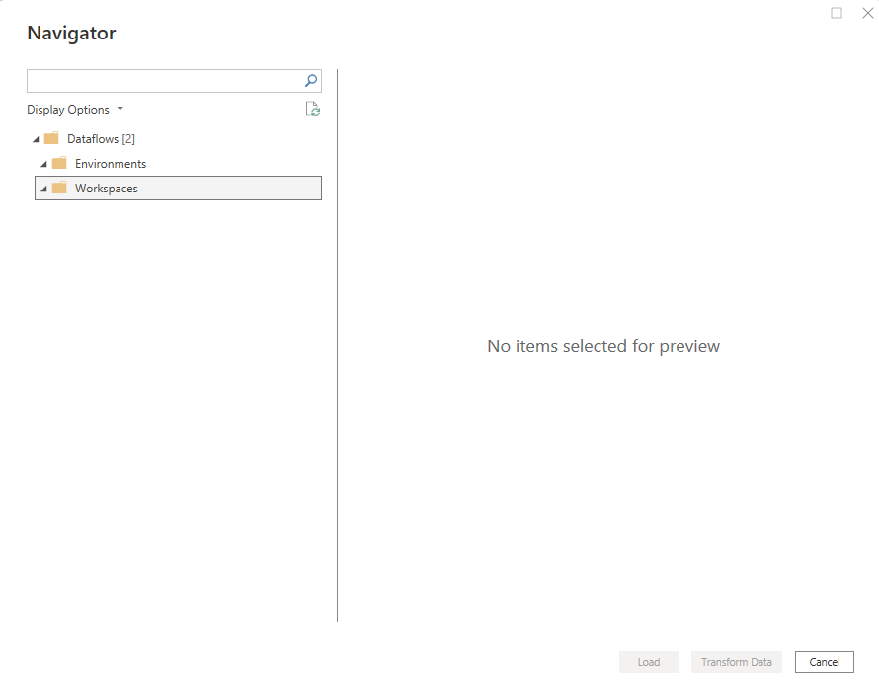
Working with Data flows
If Opened first time then there is not defined Dataflows yet

Slide 5

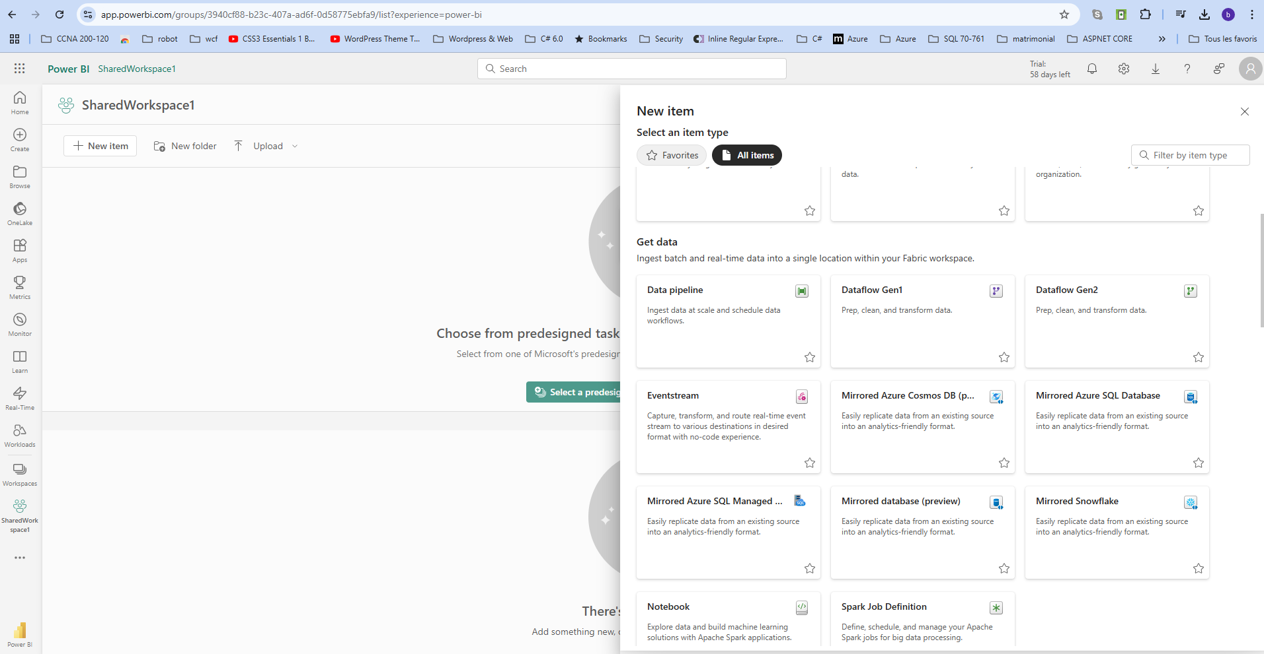
Working with Data flows
Open a Power BI Services session and open the shared workspace , click and then
choose DataFlow

Slide 6
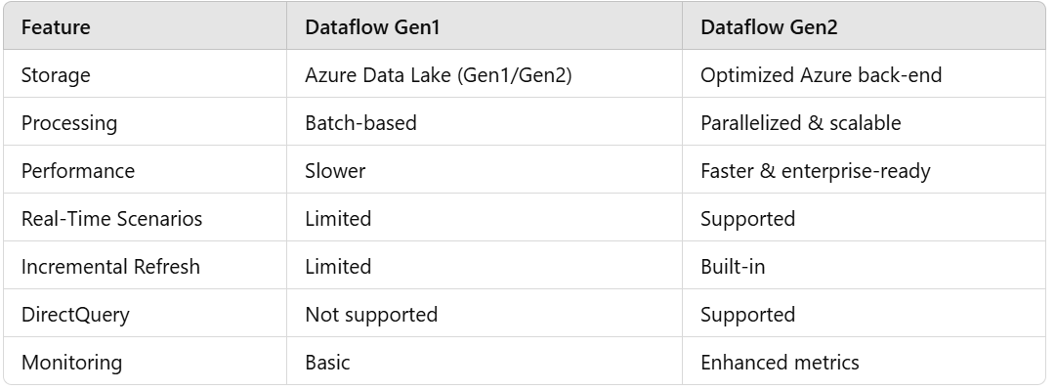
Working with Data flows
Here is some key differences between the both dataflow versions

Slide 7
Working with Data flows
Open a Power BI Services session and open the shared workspace , click and then
choose DataFlow

Slide 8
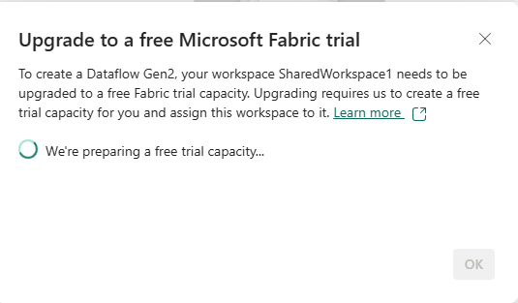
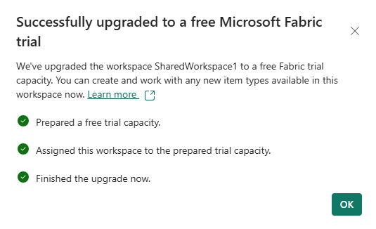
Working with Data flows
Open a Power BI Services session and open the shared workspace , click and then
choose DataFlow

Slide 9
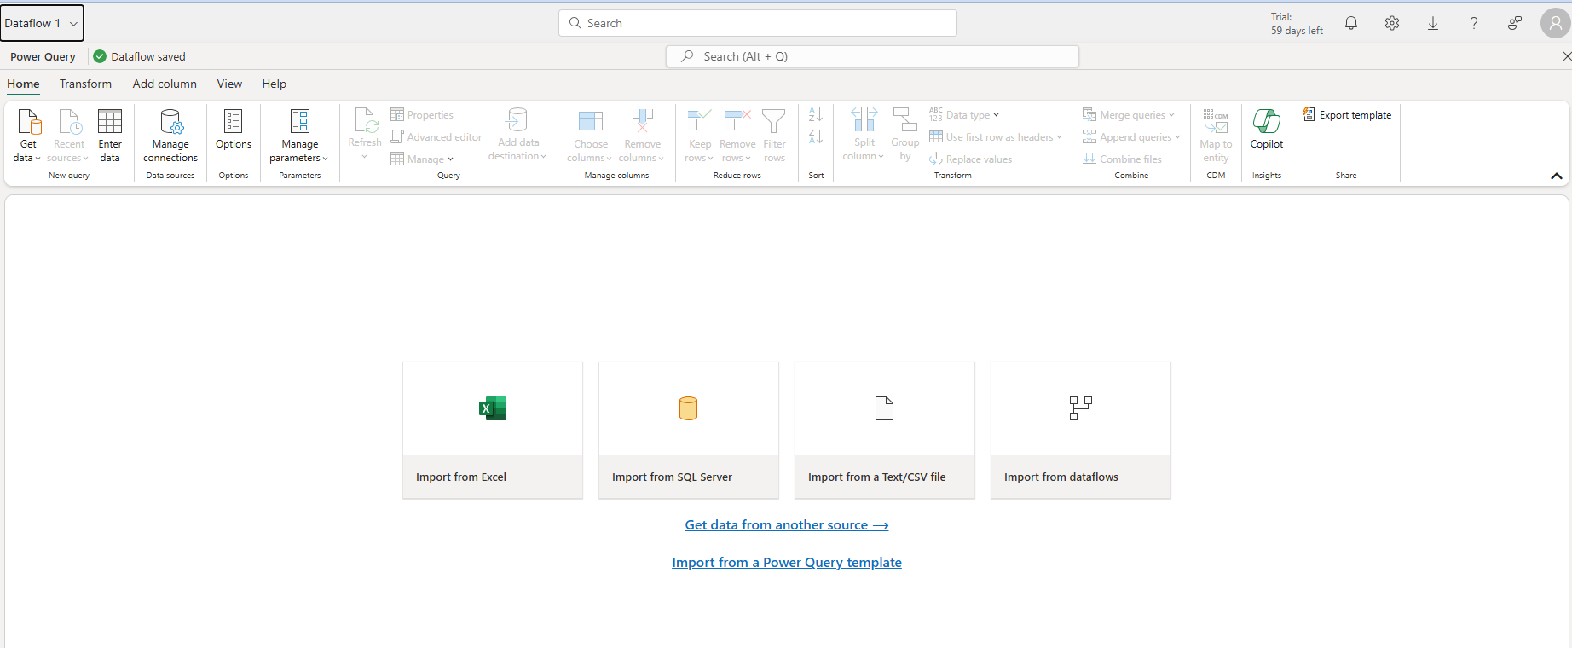
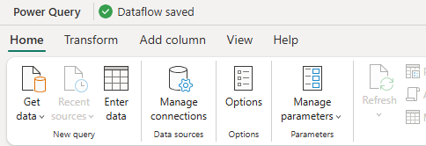
Working with Data flows
Note that we have a similar to Power BI Desktop environment

Slide 10
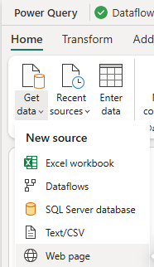
Working with Data flows
Select Get data then Web page

Slide 11
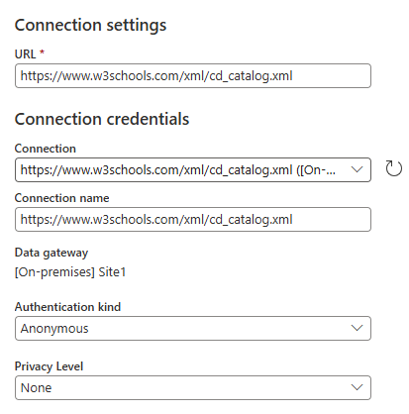
Working with Data flows
Then configure the data source to be
https://www.w3schools.com/xml/cd_catalog.xml

Slide 12
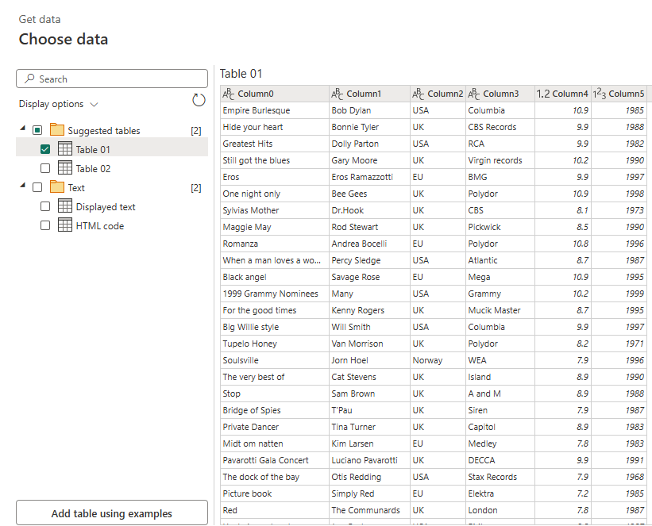
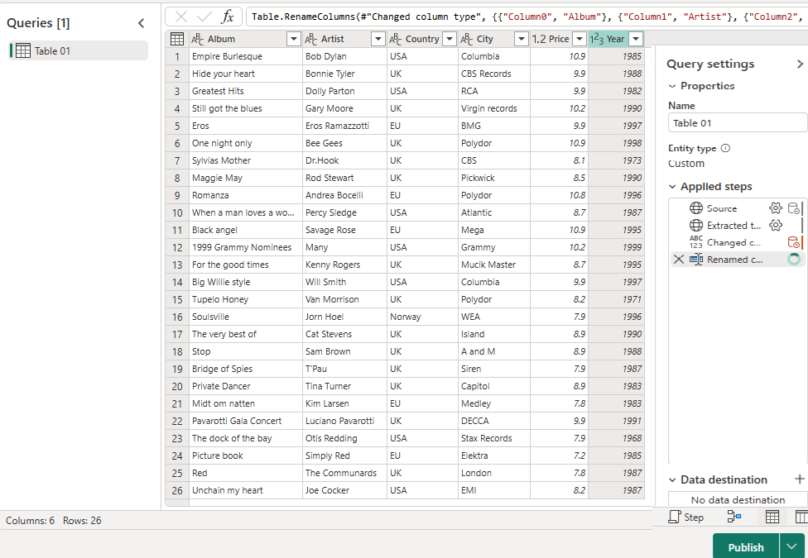
Working with Data flows
Select Table 01,it will be our data source and click Create
Change the column headers to more significants names the click Publish

Slide 13
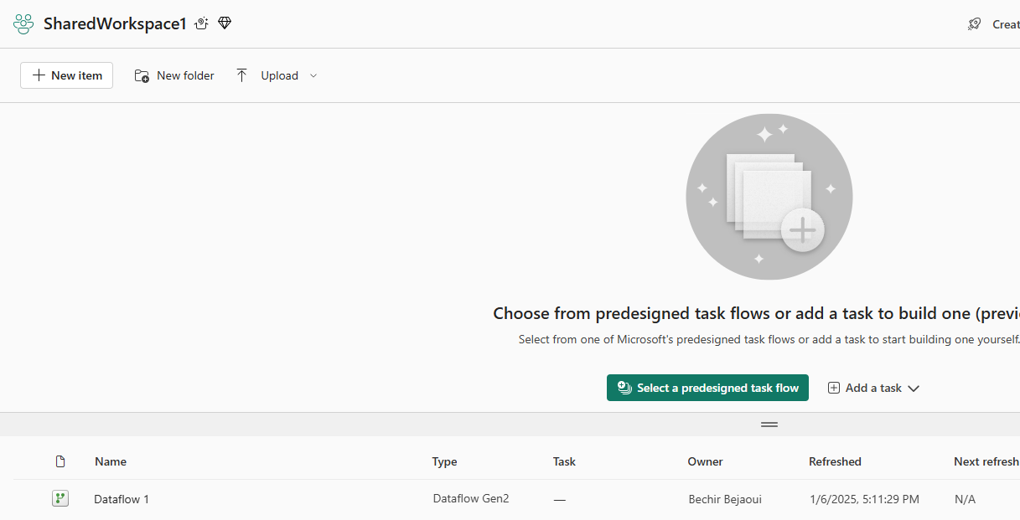
Working with Data flows
Select Table 01,it will be our data source and click Create
Change the column headers to more significant names the click Publish, we should notice the presence of that newly created dataflow

Slide 14
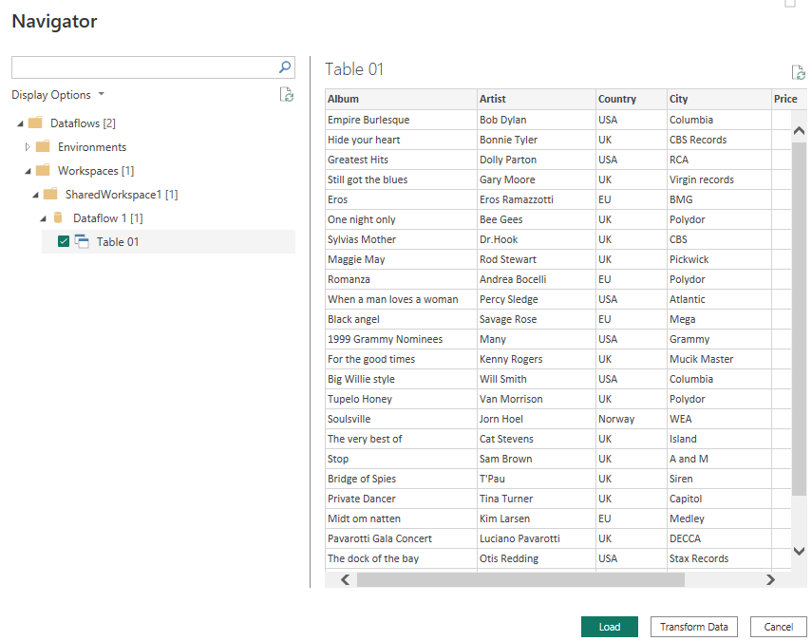
Working with Data flows
Notice the presence of the dataflow now in Power BI Desktop, data is ready now to be used

Slide 15
Thank you
Thank you

